Slide 1

Department of Cyber Security
2026-2027- Odd Semester
III Year /V Sem
CS23533-FOUNDATIONS OF ARTIFICIAL INTELLIGENCE
Review 1– 09.10.2026

Slide 2
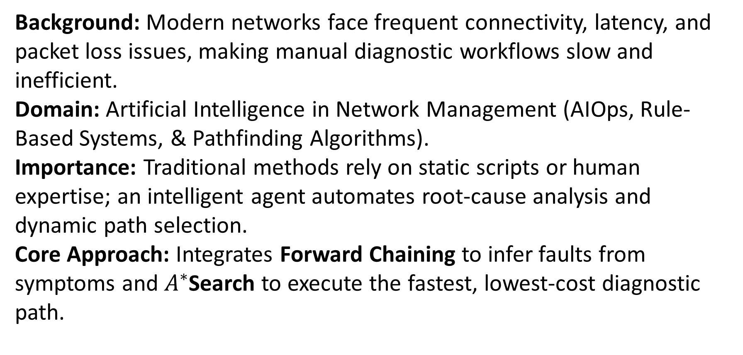
Introduction
2
Background: Modern networks face frequent connectivity, latency, and packet loss issues, making manual diagnostic workflows slow and inefficient.
Domain: Artificial Intelligence in Network Management (AIOps, Rule-Based Systems, & Pathfinding Algorithms).
Importance: Traditional methods rely on static scripts or human expertise; an intelligent agent automates root-cause analysis and dynamic path selection.
Core Approach: Integrates Forward Chaining to infer faults from symptoms and $A^{∗}$Search to execute the fastest, lowest-cost diagnostic path.
[Department] | Project Review – 1 | [Academic Year]

Slide 3
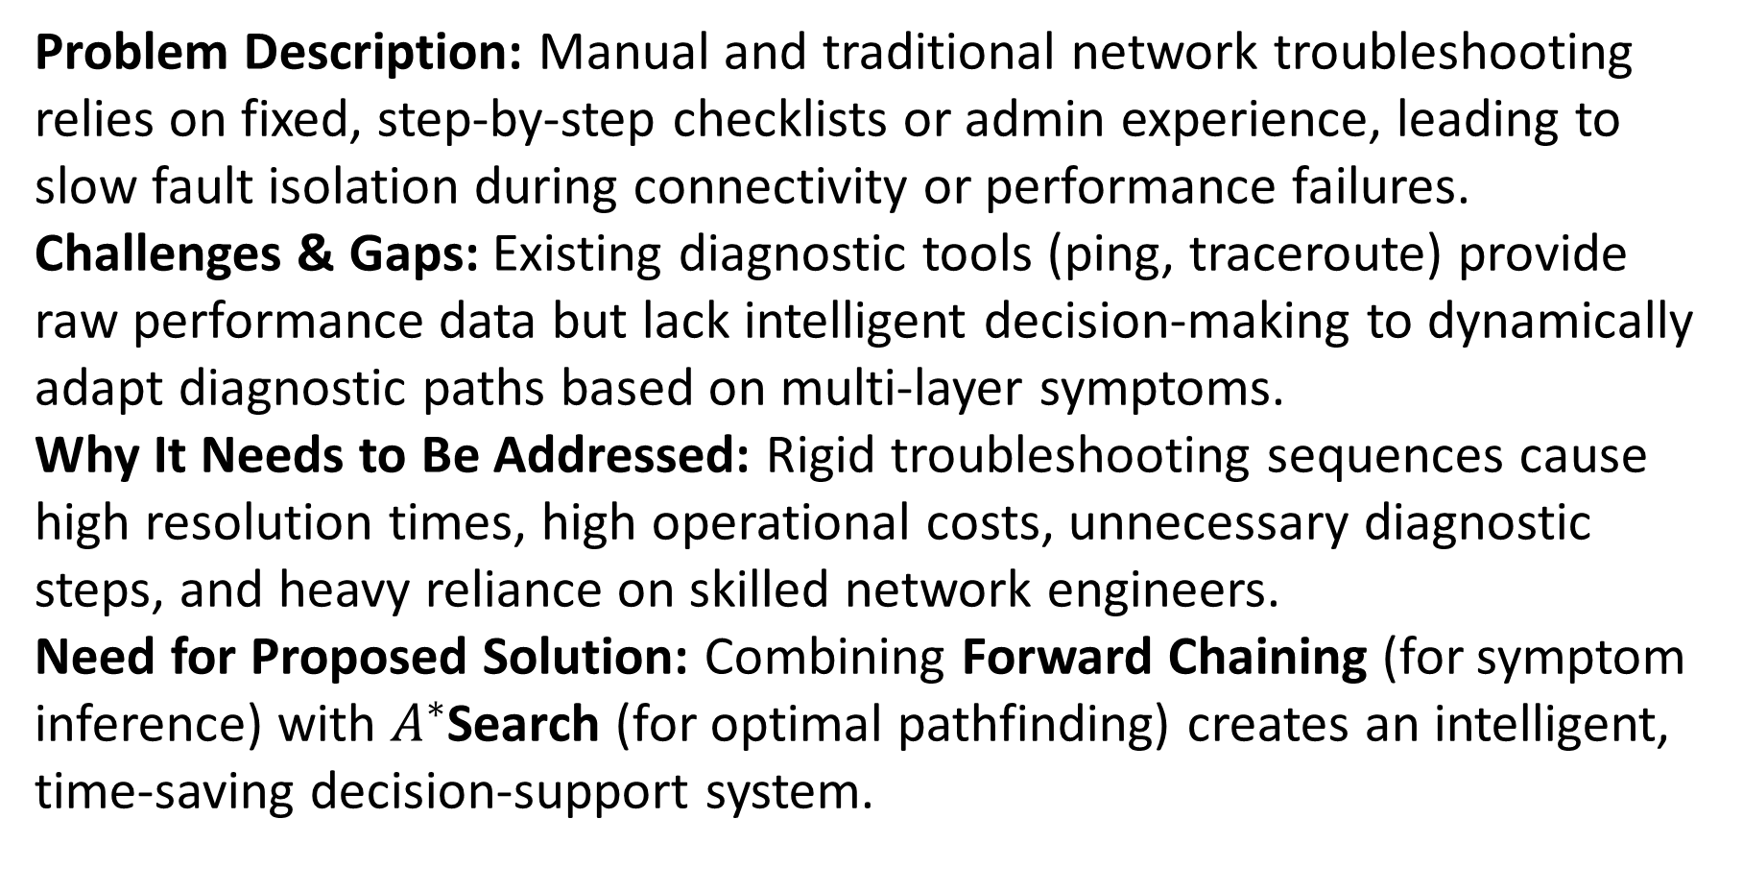
Problem Statement
3
Problem Description: Manual and traditional network troubleshooting relies on fixed, step-by-step checklists or admin experience, leading to slow fault isolation during connectivity or performance failures.
Challenges & Gaps: Existing diagnostic tools (ping, traceroute) provide raw performance data but lack intelligent decision-making to dynamically adapt diagnostic paths based on multi-layer symptoms.
Why It Needs to Be Addressed: Rigid troubleshooting sequences cause high resolution times, high operational costs, unnecessary diagnostic steps, and heavy reliance on skilled network engineers.
Need for Proposed Solution: Combining Forward Chaining (for symptom inference) with $A^{∗}$Search (for optimal pathfinding) creates an intelligent, time-saving decision-support system.
[Department] | Project Review – 1 | [Academic Year]

Slide 4
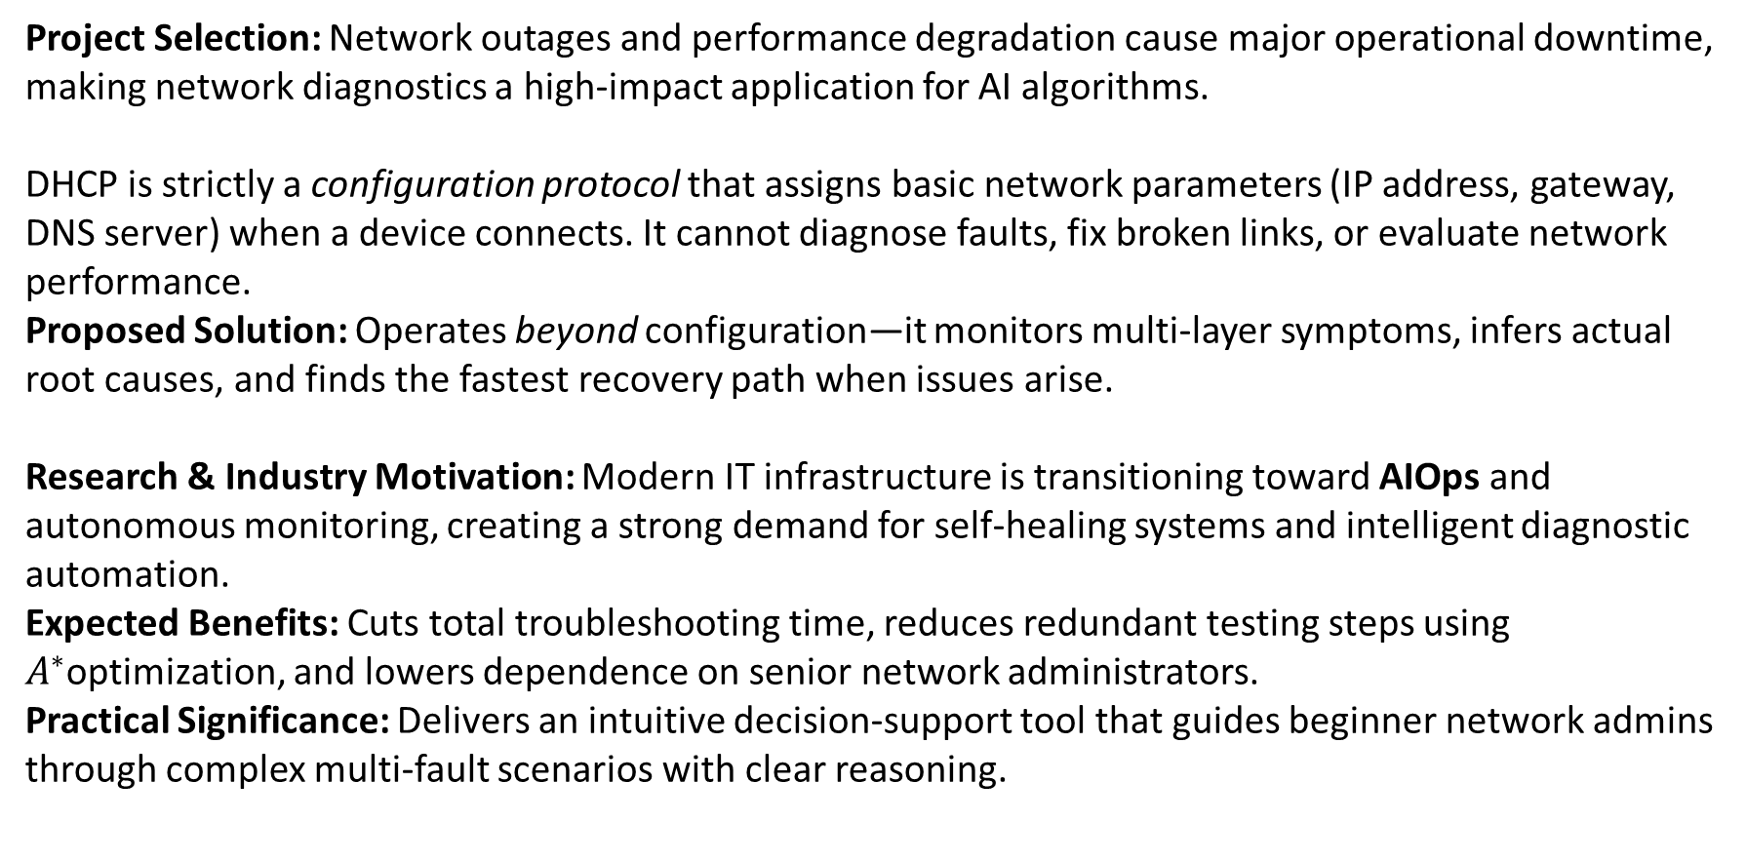
Motivation
4
Project Selection: Network outages and performance degradation cause major operational downtime, making network diagnostics a high-impact application for AI algorithms.
DHCP is strictly a configuration protocol that assigns basic network parameters (IP address, gateway, DNS server) when a device connects. It cannot diagnose faults, fix broken links, or evaluate network performance.
Proposed Solution: Operates beyond configuration—it monitors multi-layer symptoms, infers actual root causes, and finds the fastest recovery path when issues arise.
Research & Industry Motivation: Modern IT infrastructure is transitioning toward AIOps and autonomous monitoring, creating a strong demand for self-healing systems and intelligent diagnostic automation.
Expected Benefits: Cuts total troubleshooting time, reduces redundant testing steps using $A^{∗}$optimization, and lowers dependence on senior network administrators.
Practical Significance: Delivers an intuitive decision-support tool that guides beginner network admins through complex multi-fault scenarios with clear reasoning.
[Department] | Project Review – 1 | [Academic Year]

Slide 5
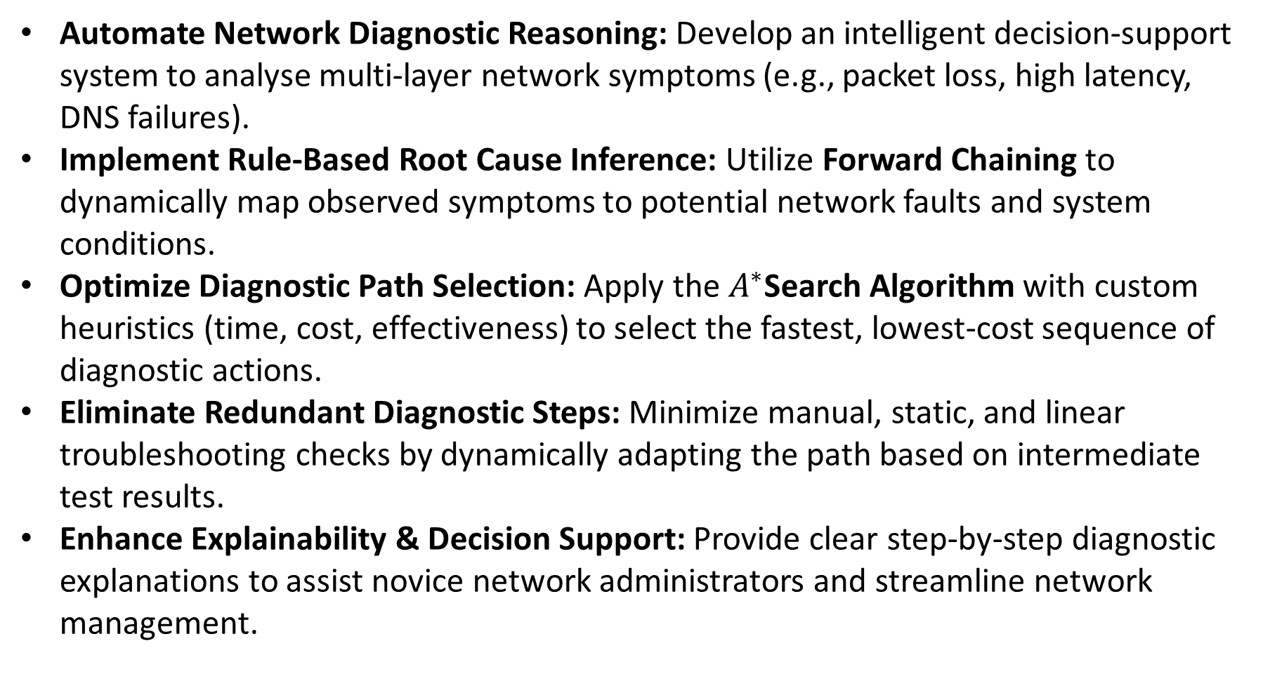
Objectives
5
Automate Network Diagnostic Reasoning: Develop an intelligent decision-support system to analyse multi-layer network symptoms (e.g., packet loss, high latency, DNS failures).
Implement Rule-Based Root Cause Inference: Utilize Forward Chaining to dynamically map observed symptoms to potential network faults and system conditions.
Optimize Diagnostic Path Selection: Apply the $A^{∗}$Search Algorithm with custom heuristics (time, cost, effectiveness) to select the fastest, lowest-cost sequence of diagnostic actions.
Eliminate Redundant Diagnostic Steps: Minimize manual, static, and linear troubleshooting checks by dynamically adapting the path based on intermediate test results.
Enhance Explainability & Decision Support: Provide clear step-by-step diagnostic explanations to assist novice network administrators and streamline network management.
[Department] | Project Review – 1 | [Academic Year]

Slide 6
Literature Survey
6
S.No. | Author & Year | Method / Technique | Key Findings | Limitations
1 | Young J.Won , Mi-Jung Choi, James Won-Ki Hong,Myung-Sup Kim,Hwawon Hwang,Jun-Hyub Lee,Sung-Gyoo Lee - 2008 | Network Fault Detection & Diagnosis | Inadequacy of traditional monitoring tools Crucial role of early symptom detection Data mining over static rules Fine-grained feature extraction | Primitive diagnostic logic Heavy reliance on labeled training data Lack of dynamic path planning Static rule sets
2 | Yingying Wang-2009 | Expert System, Fault Tree Reasoning | Solves the rule explosion bottleneck Hybrid shallow and deep knowledge base Two-way inference improvement | Static failure structure Lack of path/cost optimization No sequential adaptive reasoning Inability to handle novel/compound failures
3 | Zi Jian Yang,Yong Wang-2017 | Knowledge-Based Fault Diagnosis, Rule-Based Reasoning | Efficient Failure Isolation Separation of Knowledge and control Effective handling of deterministic faults | Rule Matching Overhead and performance bottlenecks Lack of optimal execution planning Brittle knowledge base Absence of dynamic path adaptation
[Department] | Project Review – 1 | [Academic Year]

Slide 7
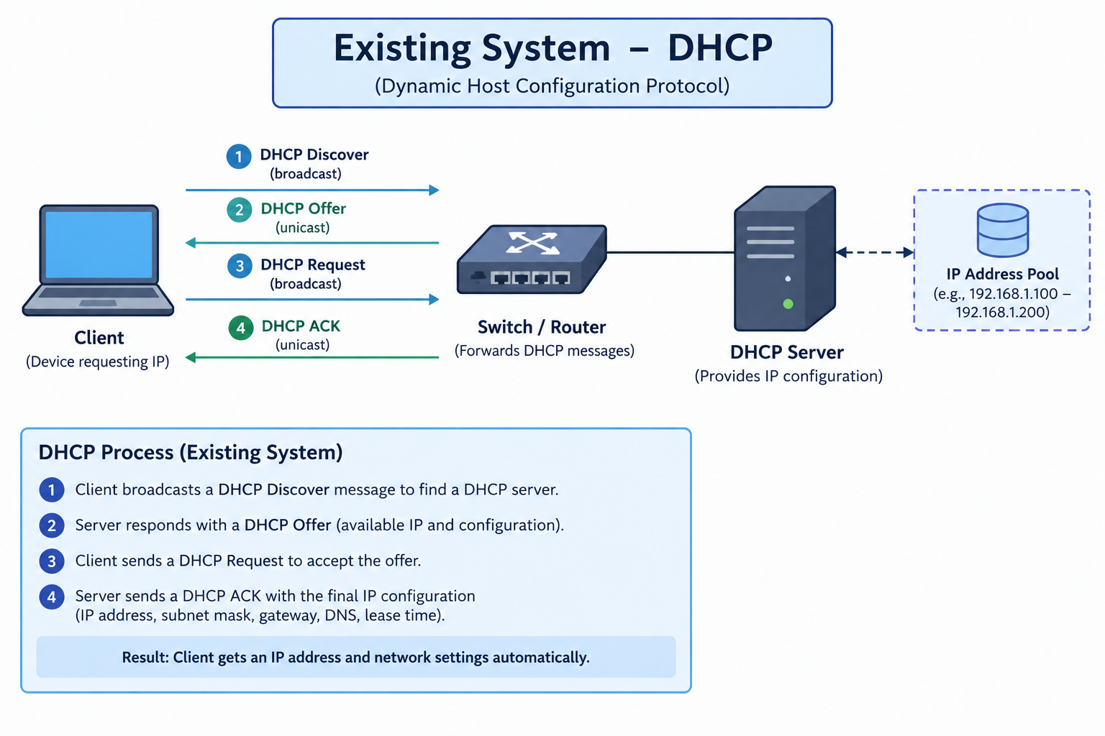
Existing System
7
Static Checklists & Standard Operating Procedures (SOPs): Manual, linear troubleshooting following fixed diagnostic steps
Command-Line Diagnostic Utilities: Direct execution of tools like ping, traceroute, nslookup, and netstat by human administrators.
Technologies & Algorithms Used:
DHCP & Auto-Configuration Protocols: Handles IP address dynamic allocation, default gateways, and DNS settings upon connection.
Basic Scripting & Decision Trees: Simple if-else automation scripts and static flowcharts.
Advantages:
Simple, predictable, and standardized for routine network setup and basic configurations.
Native availability across all operating systems without requiring advanced AI infrastructure.
Limitations (Gaps to Address):
No Path Optimization: Executes tests sequentially without considering execution time, cost, or likelihood of success.
Inability to Self-Adapt: Static scripts cannot re-route diagnostic logic if an unexpected error or intermediate failure occurs.
Data Without Decisions: Output tools report raw performance metrics but rely heavily on skilled engineers to interpret root causes.
[Department] | Project Review – 1 | [Academic Year]

Slide 8
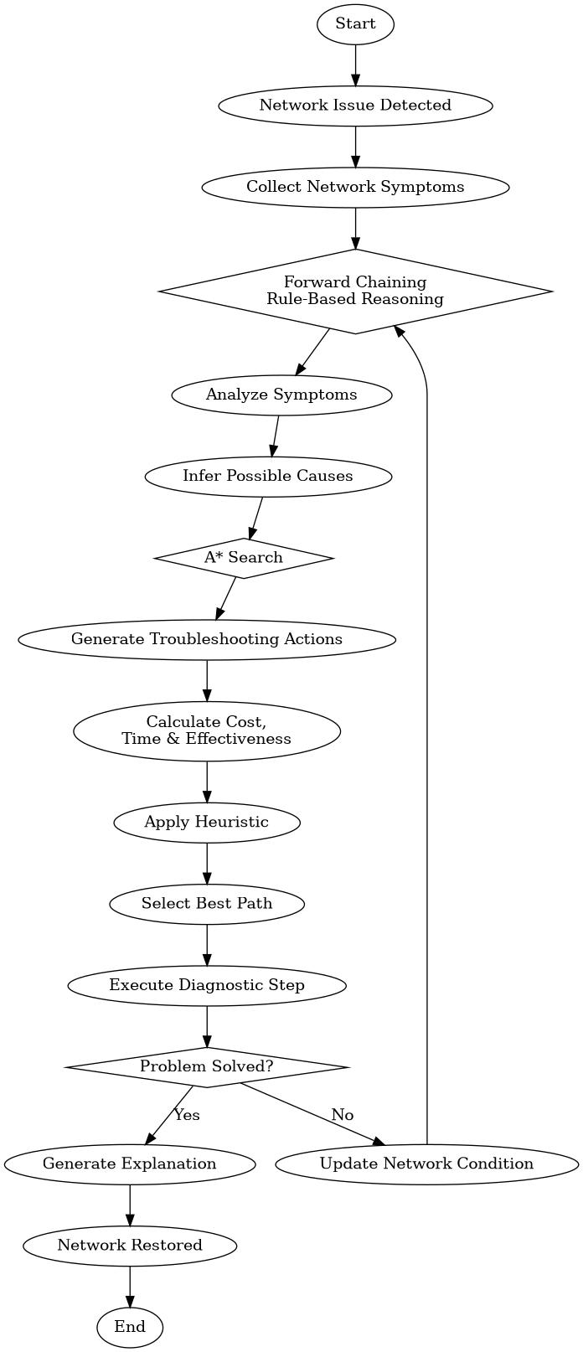
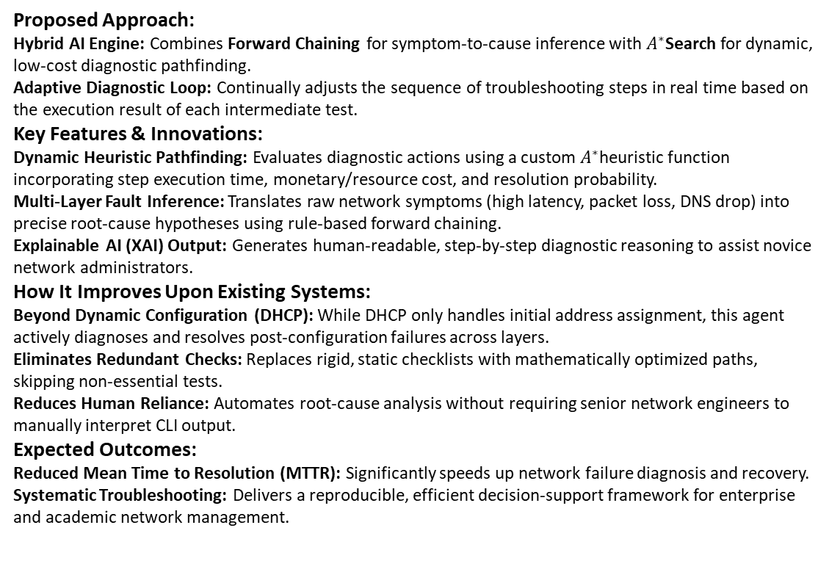
Proposed System
8
Proposed Approach:
Hybrid AI Engine: Combines Forward Chaining for symptom-to-cause inference with $A^{∗}$Search for dynamic, low-cost diagnostic pathfinding.
Adaptive Diagnostic Loop: Continually adjusts the sequence of troubleshooting steps in real time based on the execution result of each intermediate test.
Key Features & Innovations:
Dynamic Heuristic Pathfinding: Evaluates diagnostic actions using a custom $A^{∗}$heuristic function incorporating step execution time, monetary/resource cost, and resolution probability.
Multi-Layer Fault Inference: Translates raw network symptoms (high latency, packet loss, DNS drop) into precise root-cause hypotheses using rule-based forward chaining.
Explainable AI (XAI) Output: Generates human-readable, step-by-step diagnostic reasoning to assist novice network administrators.
How It Improves Upon Existing Systems:
Beyond Dynamic Configuration (DHCP): While DHCP only handles initial address assignment, this agent actively diagnoses and resolves post-configuration failures across layers.
Eliminates Redundant Checks: Replaces rigid, static checklists with mathematically optimized paths, skipping non-essential tests.
Reduces Human Reliance: Automates root-cause analysis without requiring senior network engineers to manually interpret CLI output.
Expected Outcomes:
Reduced Mean Time to Resolution (MTTR): Significantly speeds up network failure diagnosis and recovery.
Systematic Troubleshooting: Delivers a reproducible, efficient decision-support framework for enterprise and academic network management.
[Department] | Project Review – 1 | [Academic Year]

Slide 9
System Architecture / Block Diagram
9
Network symptoms &Logs(packet loss, High Latency, DNS Dropouts,
Connectivity loss
Symptom Normalization &Fact Mapping (Extracts network condition and maps them to initial facts in the knowledge base
Dynamic Action Testing & Heuristic Assessment (Evaluates test g(n), and estimated effort h(n))
Optimal Diagnostic Path & Resolution Report
(Recommended repair steps +human-readable reasoning log
Hybrid AI Engine (Forward Chaining for root cause inference + A* Search for path optimization
[Department] | Project Review – 1 | [Academic Year]

Slide 10
Methodology
10
1. Collects raw logs and performance metrics
2.Converts unstructured network logs into structured Boolean facts for the knowledge base
3. Rule-Based Inference Engine (Forward Chaining)
4. Optimal path search Algorithm ( A* Algorithm)
5. Dynamic Step Execution & Adaptive Rerouting
6. Decision-support and Remediation Report
Step 1–2 (Data & Preprocessing): Continuous monitoring captures network anomalies and maps raw indicators to assertion facts in the knowledge base.
Step 3 (Reasoning): Forward Chaining evaluates facts iteratively to narrow down possible network fault causes.
Step 4 (Optimization): A* Search selects the most efficient troubleshooting path based on step cost, execution time, and resolution probability.
Step 5–6 (Execution & Reporting): Performs adaptive re-evaluations after each action and delivers actionable recommendations for network administrators.
[Department] | Project Review – 1 | [Academic Year]

Slide 11
Technologies Used
11
Programming Language: Python, HTML,CSS,JSON
Framework :
Flask- Python web framework used to build the web application to handle routes, requests, responses.
Jinja2-Template engine used with Flask to create dynamic HTML pages.
Libraries:
Python json - To read and manage the knowledge base and case base stored in JSON files
Python heapq – Used in the A* Search implementation for priority-queue operations
Python os- Used for file and knowledge-based management
Flask libraries- Flask, render_template, request, and session
Database:
SQLite-lightweight relational database used to store network diagnosis and troubleshooting history
Python library- sqlite3-used to connect Python/Flask with SQLite.
Tools / IDE: VS Code, Git Bash, Python Virtual Environment, Web browser(Chrome/Edge), Git
Hardware Requirements: Processor:Intel Core i3 or above, RAM: Minimum 4GB
[Department] | Project Review – 1 | [Academic Year]

Slide 12
Module Description
12
Module 1 – System Setup & Knowledge Representation
Module 2 – AI-Based Network Diagnosis
Module 3 – Adaptive & Case-Based Intelligence
Module 4 – Data Management & Reporting
Module 5 - Analytics, Testing & Finalization
[Department] | Project Review – 1 | [Academic Year]

Slide 13
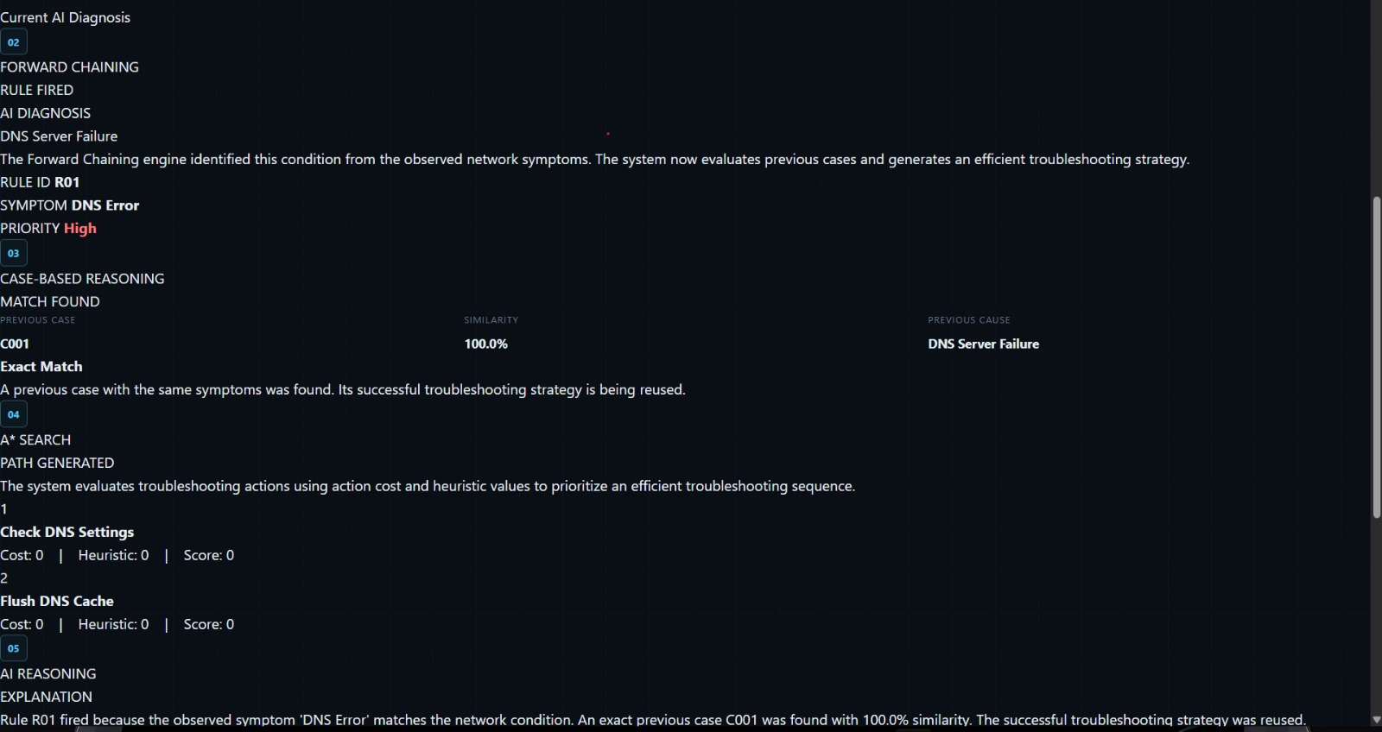
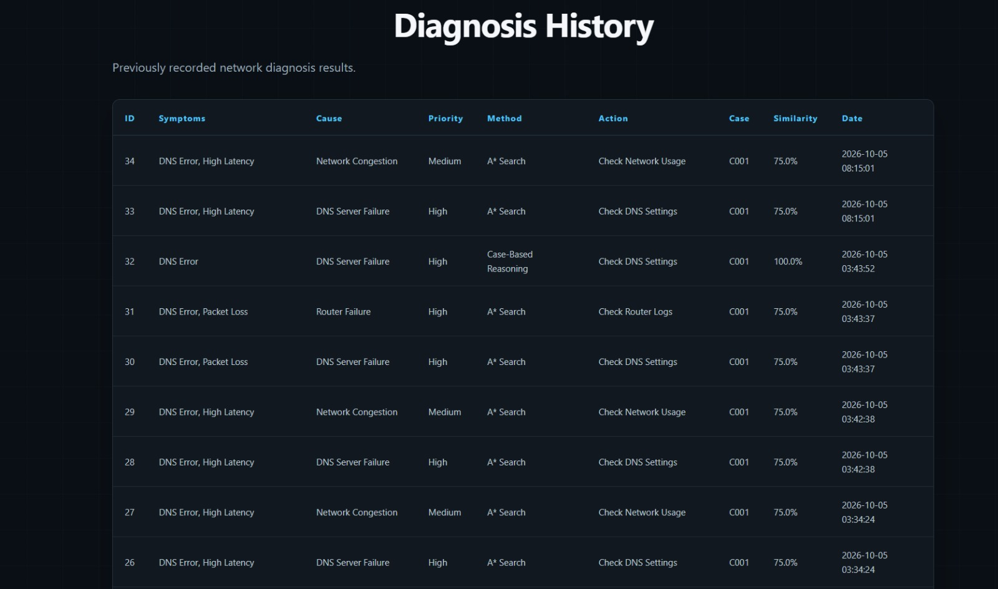
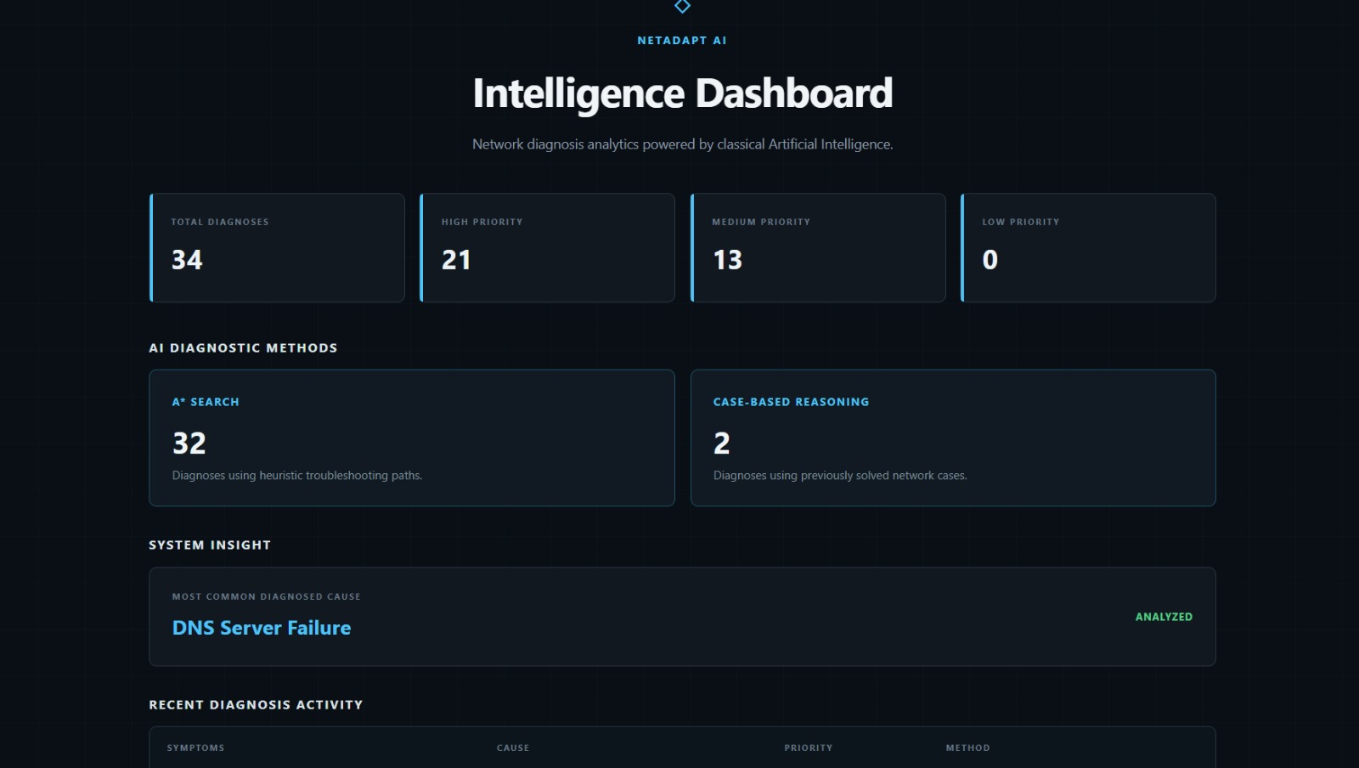
Preliminary / Expected Results
13
[Department] | Project Review – 1 | [Academic Year]

Slide 14
Project Schedule
14
Activity | Month 1 | Month 2 | Month 3 | Month 4
Literature Survey | ✓
Problem Identification | ✓
System Design |  | ✓
Implementation |  | ✓ | ✓
Testing & Evaluation |  |  | ✓
[Department] | Project Review – 1 | [Academic Year]

Slide 15
Current Progress
15
✓ Literature survey completed
✓ Problem identification completed
✓ Requirement analysis / methodology finalized
Implementation completed
Testing completed
☐ Final evaluation completed
[Department] | Project Review – 1 | [Academic Year]

Slide 16
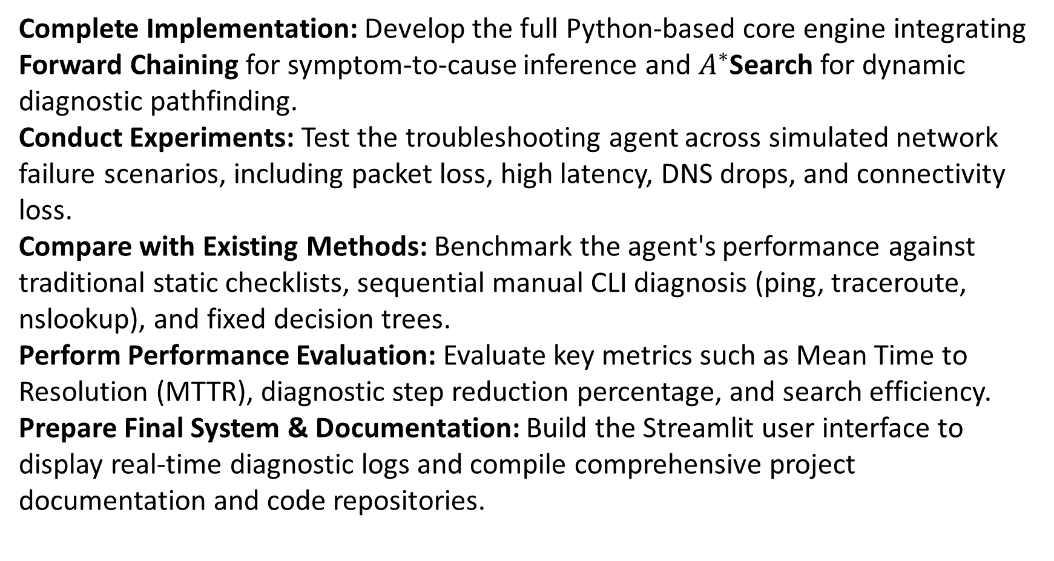
Future Work
16
Complete Implementation: Develop the full Python-based core engine integrating Forward Chaining for symptom-to-cause inference and $A^{∗}$Search for dynamic diagnostic pathfinding.
Conduct Experiments: Test the troubleshooting agent across simulated network failure scenarios, including packet loss, high latency, DNS drops, and connectivity loss.
Compare with Existing Methods: Benchmark the agent's performance against traditional static checklists, sequential manual CLI diagnosis (ping, traceroute, nslookup), and fixed decision trees.
Perform Performance Evaluation: Evaluate key metrics such as Mean Time to Resolution (MTTR), diagnostic step reduction percentage, and search efficiency.
Prepare Final System & Documentation: Build the Streamlit user interface to display real-time diagnostic logs and compile comprehensive project documentation and code repositories.
[Department] | Project Review – 1 | [Academic Year]

Slide 17
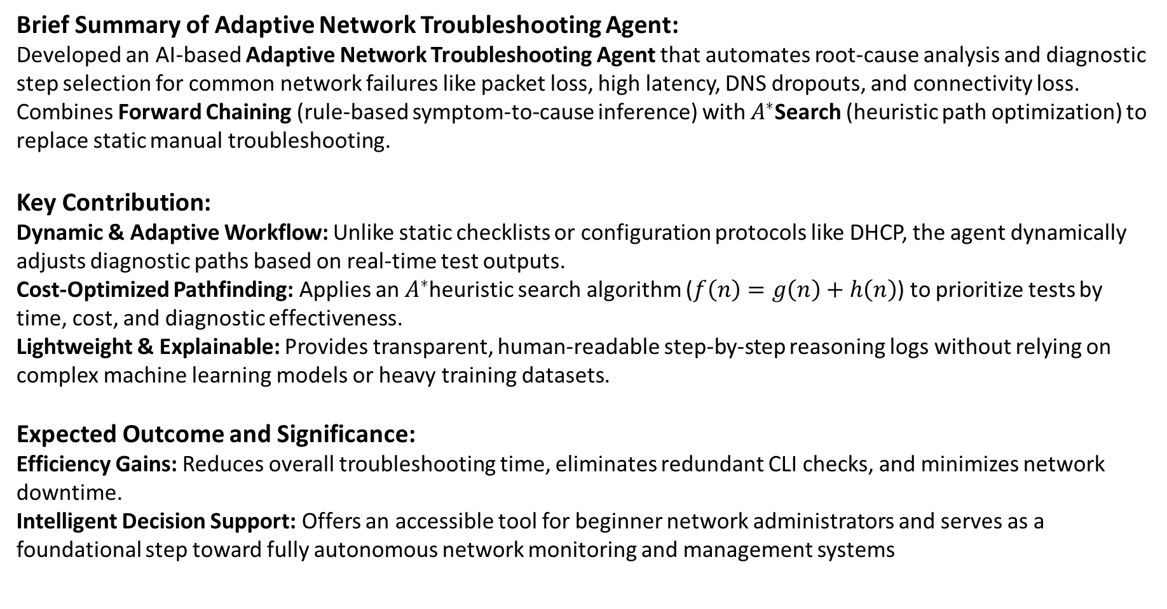
Conclusion
17
Brief Summary of Adaptive Network Troubleshooting Agent:
Developed an AI-based Adaptive Network Troubleshooting Agent that automates root-cause analysis and diagnostic step selection for common network failures like packet loss, high latency, DNS dropouts, and connectivity loss.
Combines Forward Chaining (rule-based symptom-to-cause inference) with $A^{∗}$Search (heuristic path optimization) to replace static manual troubleshooting.
Key Contribution:
Dynamic & Adaptive Workflow: Unlike static checklists or configuration protocols like DHCP, the agent dynamically adjusts diagnostic paths based on real-time test outputs.
Cost-Optimized Pathfinding: Applies an $A^{∗}$heuristic search algorithm ($f\left(n\right)=g\left(n\right)+h\left(n\right)$) to prioritize tests by time, cost, and diagnostic effectiveness.
Lightweight & Explainable: Provides transparent, human-readable step-by-step reasoning logs without relying on complex machine learning models or heavy training datasets.
Expected Outcome and Significance:
Efficiency Gains: Reduces overall troubleshooting time, eliminates redundant CLI checks, and minimizes network downtime.
Intelligent Decision Support: Offers an accessible tool for beginner network administrators and serves as a foundational step toward fully autonomous network monitoring and management systems
[Department] | Project Review – 1 | [Academic Year]

Slide 18
References
18
[1] John Thornadtsson, Sania Partovian, Alessio Bucaioni. (2023). Analysis of Log Files to Enable Smart- Troubleshooting in Industry 4.0: A Systemic Mapping Study.
[2] Diego Kreutz, Fernando M.V.Ramos, Paulo Esteves Verissimo. Christian Esteve Rothenberg, Siamak Azodolmolky, Steve Uhlig. (2015). Software Defined Networking: A Comprehensive Study
[3] Troubleshooting, Maintaining and Repairing PCs (Hardware) by Stephen J Bigelow
[Department] | Project Review – 1 | [Academic Year]

Slide 19
THANK YOU
Questions & Suggestions

